Slide 1
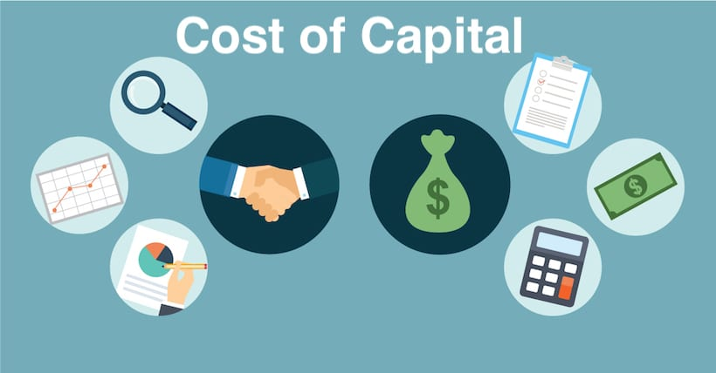

Slide 2
INTRODUCTION
The term 'cost of capital' may be defined as the required rate of return a firm must earn on his investment project, so that the market value of the firm's equity does not fall. It is the cost of obtaining funds, through debt or equity, in order to finance an investment. These funds can be procured from different types of investors.
The cost of capital of firms is a weighted average of the cost of each component of capital, i.e. combined cost of each type of source by which a firm raises funds. Thus, cost of capital is the rate which an organisation must pay to the suppliers of capital for the use of their funds.

Slide 3
DEFINITION
According to Solomon Ezra- "Cost of capital is the minimum required rate of earning or the cut-off rate of capital expenditure."
According to Hampton, John J- "The rate of return the firm requires from investment in order to increase the value of the firm in the market place."

Slide 4
Cost of capital can be computed using formula
K= r₀ + b + f
Where, K = Cost of capital
r = Normal rate of return at zero risk level
b= Premium for business risk
f = Premium for financial risk

Slide 5
Importance of Cost of Capital
The importance of cost of capital can be stated in terms of the contribution, it makes towards the achievement of the objectives of maximization of the wealth of the shareholders. If the firm's return is more than its cost of capital, then the investors will no doubt be receiving their expected rate of return from the firm. The excess portion of the return will however be available to the firms and can be used in several ways. e.g.
For distribution among the shareholders in the form of higher than expected dividends and
For reinvestment within the firm for increasing further the subsequent returns.

Slide 6
The cost of capital, when used as a discount rate in capital budgeting, helps accepting only those proposals whose rate of return is more than the cost of capital of the firm and hence, results in increasing the value of the firm. Similarly, the firm's value is reduced, when the rate of return on the proposal falls below the cost of capital. Thus, the concept of cost of capital is consistent with the goal of maximization of shareholder's wealth and it works as a tool to achieve this goal. Further, the cost of capital has a useful role to play in deciding the financial plan or capital structure of the firm. It may be noted that in order to maximize the value of the firm, the cost to all the different sources of funds must be minimized. The cost of capital of different sources usually varies and the firm will like to have a combination of these sources in such a way as to minimize the overall cost of capital of the firm.

Slide 7
THANK YOU

